Slide 1
HUb and spoke model
Was able to ping all spokes from the hub

Slide 2
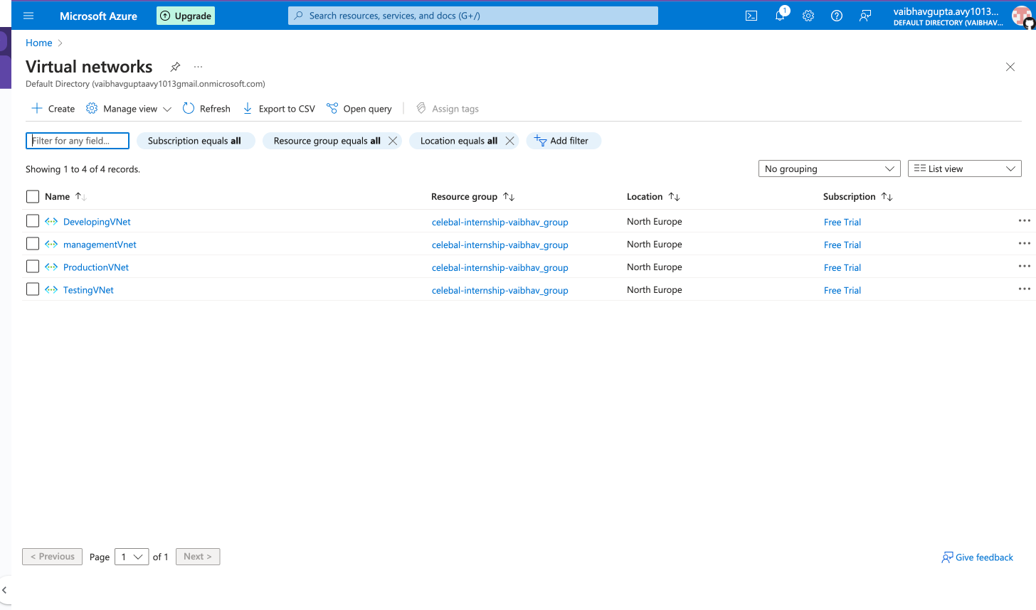
Create four virtual networks

Slide 3
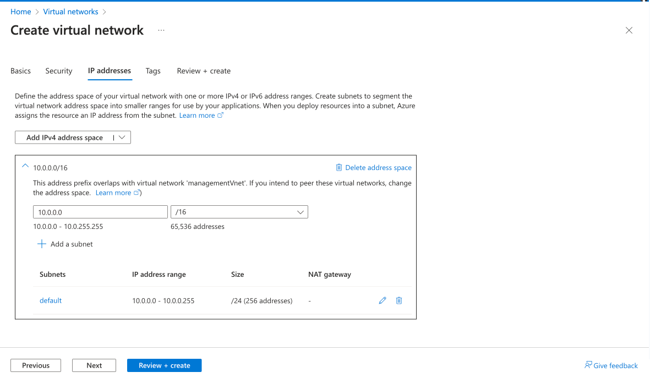
Make sure u have different subnets so ip don’t overlap
10.0.0.0/16
10.1.0.0/16
10.2.0.0/16
10.3.0.0/16

Slide 4
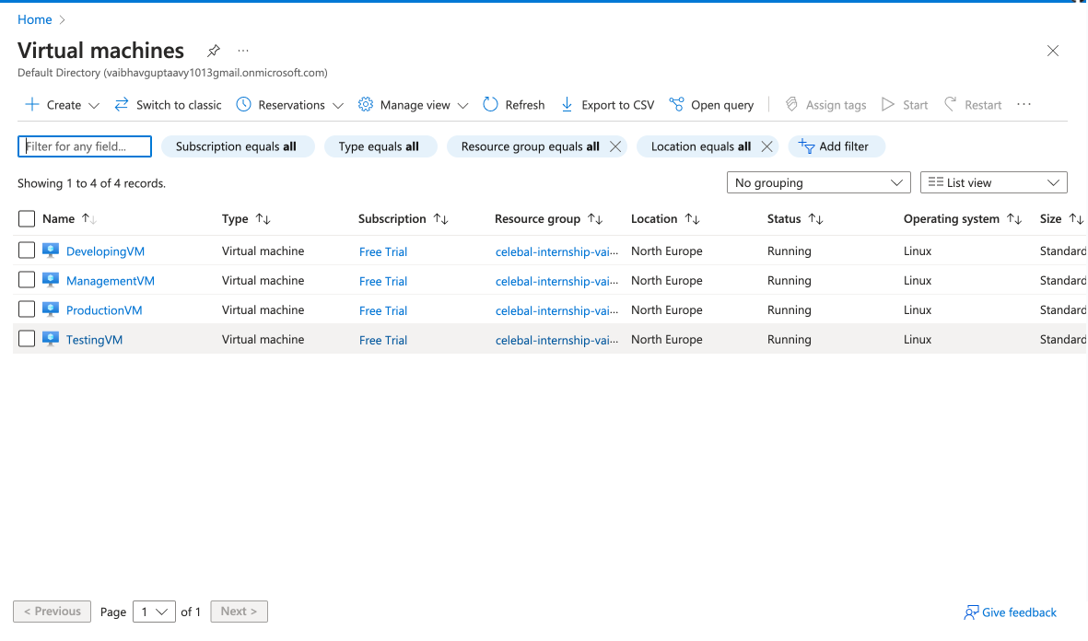
Similar create 4 vm and make sure to add them in subnets/vnets

Slide 5
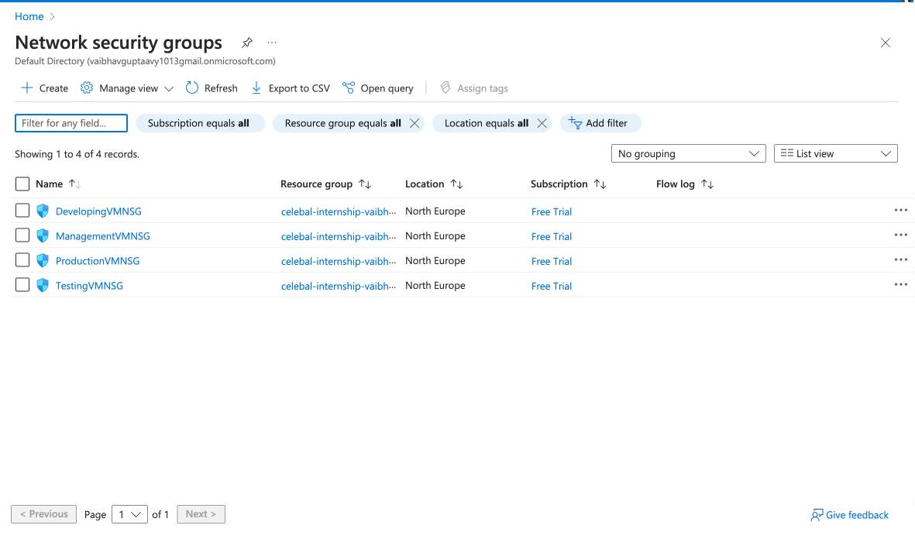
Configure your nsg for icmp protocol(ping)

Slide 6
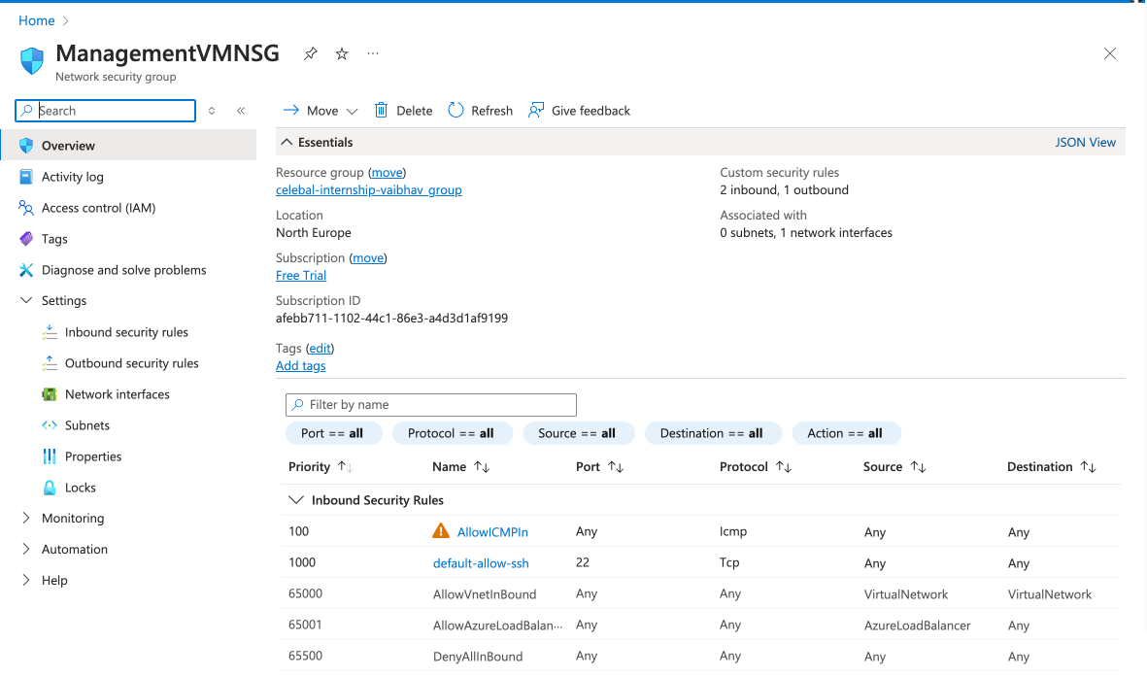
Add icmp protocol to both inbound and outbound

Slide 7
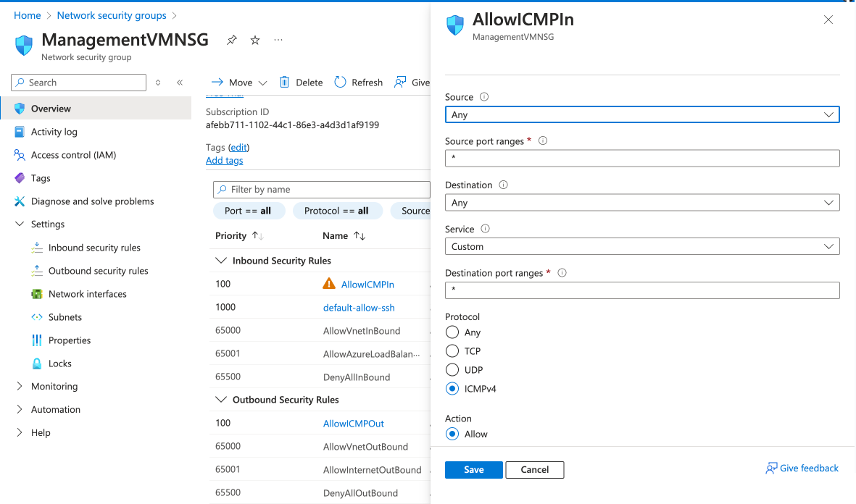

Slide 8
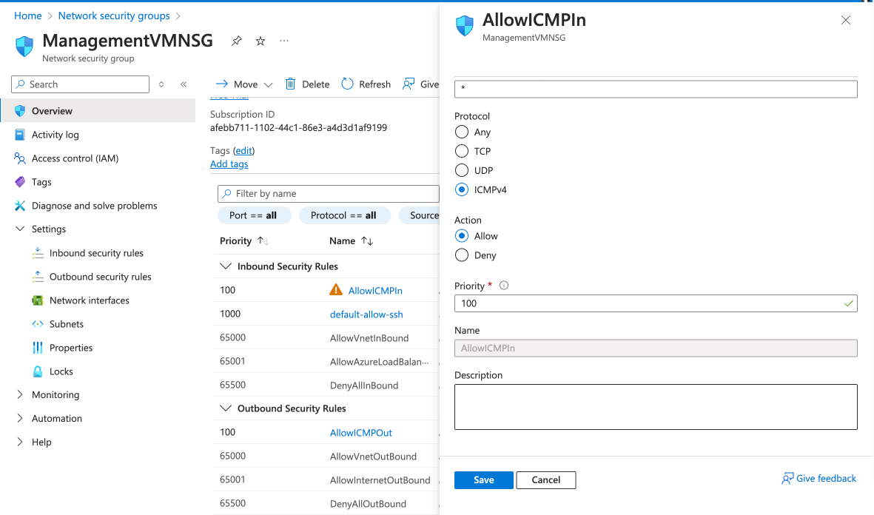
Check the priority no. if incase it does not work

Slide 9
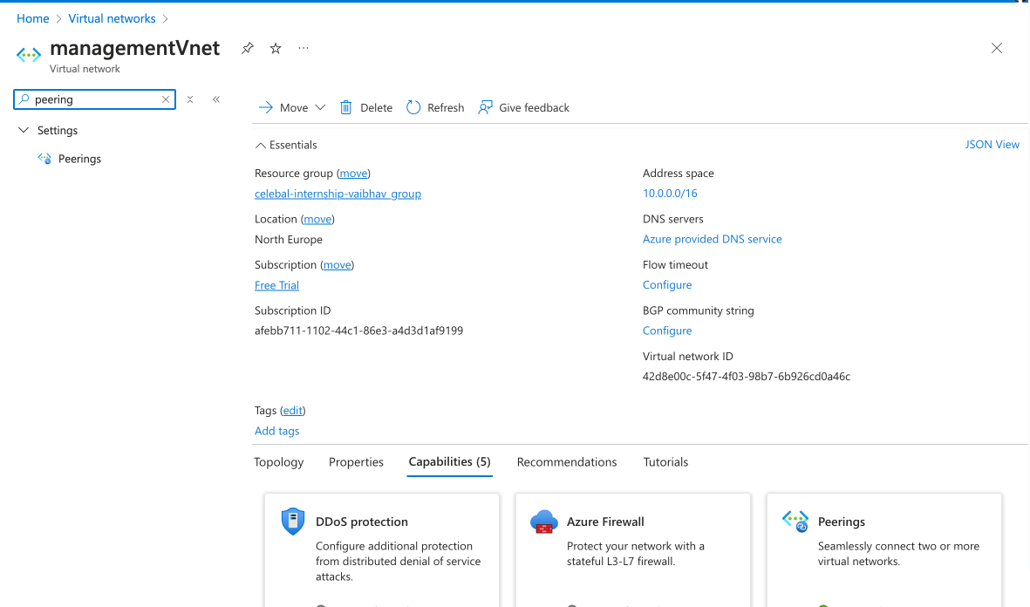
Search for peering in vnets *4 everything

Slide 10
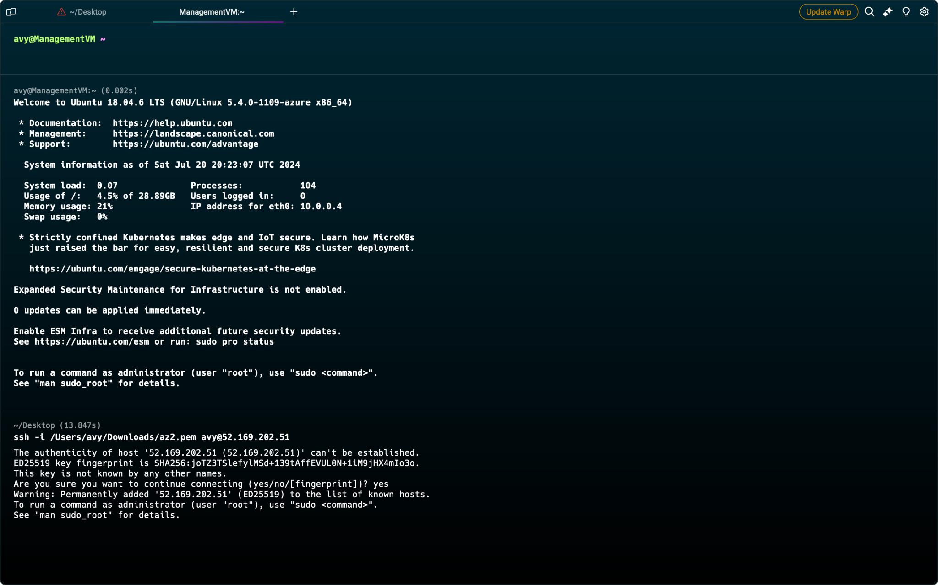
Ssh into the HUB VM

Slide 11
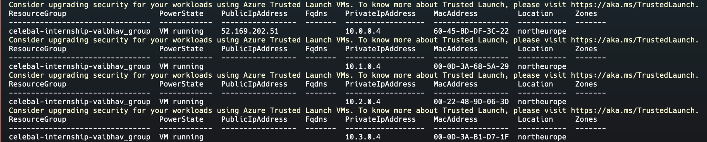
Extracted vm private ip address

Slide 12
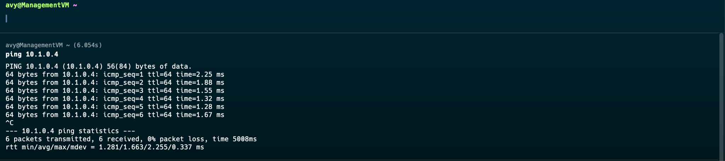
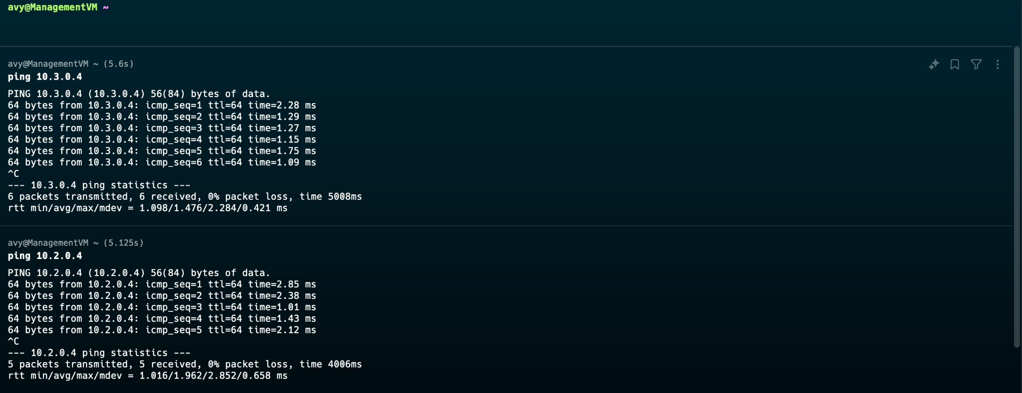
Able to ping all the VM’s

Slide 13
THANKS FOR SEEING MY EFFORTS TILL END

